Slide 1
APOLOGETICS
IN ONE LESSON
almost
Ai1L.net
Introduction

Slide 2
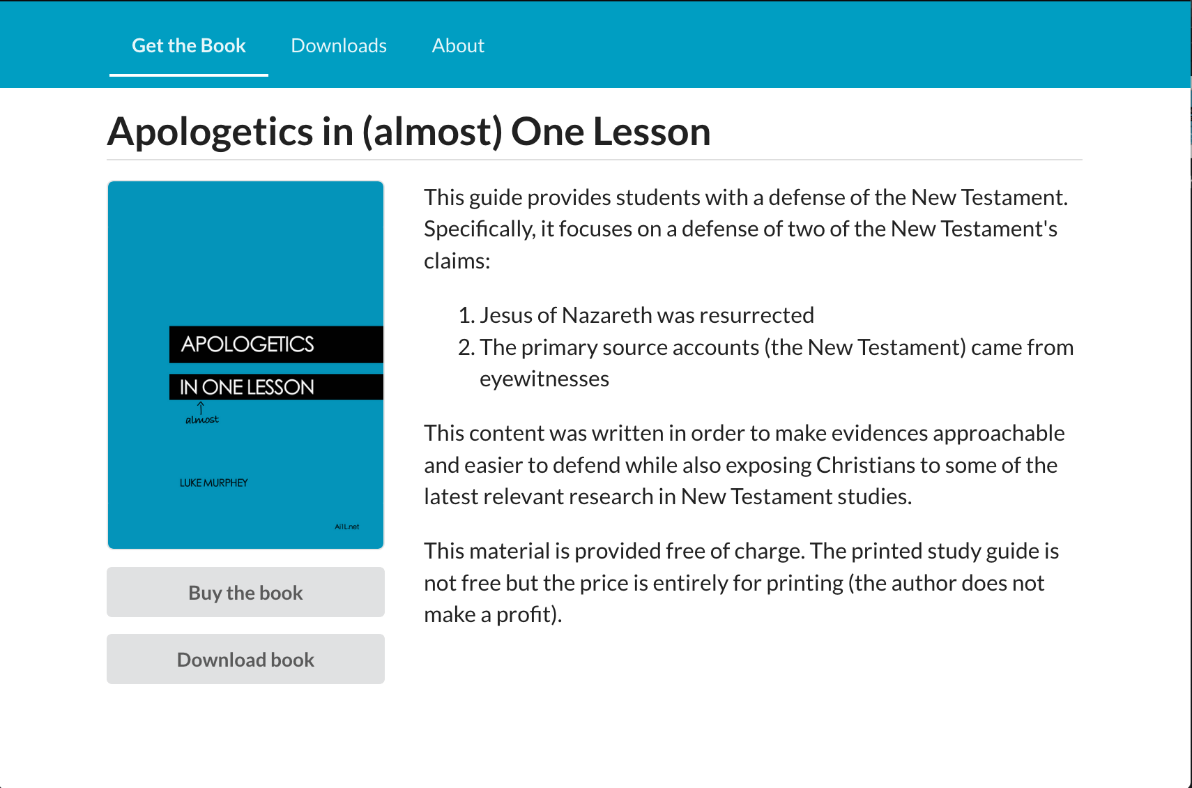
https://Ai1L.net

Slide 3
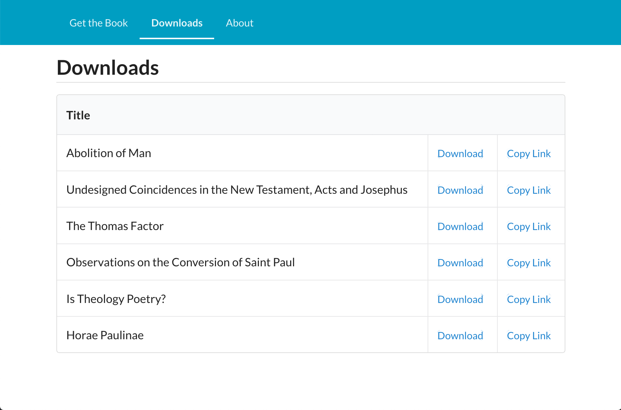

Slide 4
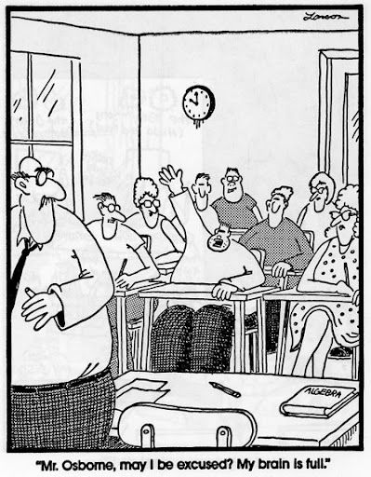

Slide 6
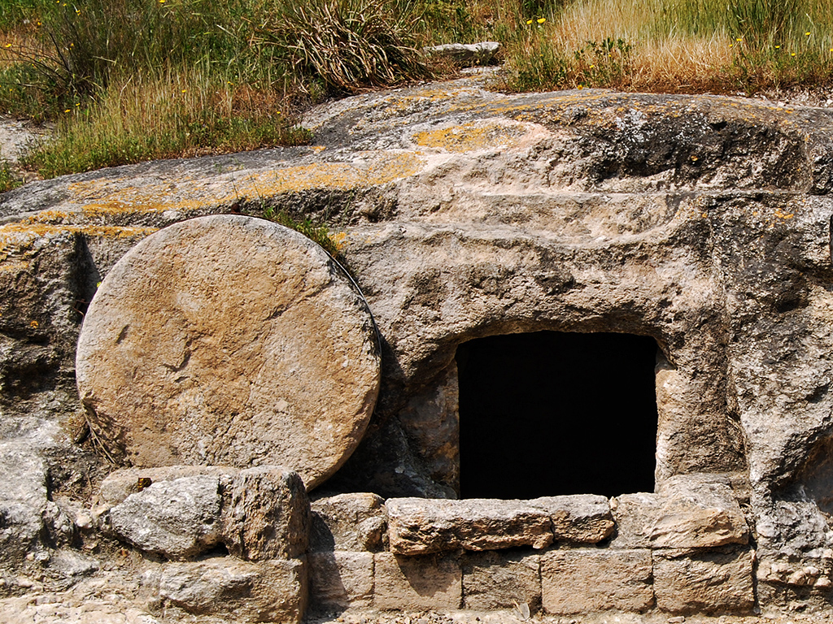
Tomb in Jezreel Valley
Photo by Ferrell Jenkins

Slide 7
Main facts
1
Jesus was resurrected
2
The New Testament came from eyewitnesses

Slide 8
Why focus on a defense of the resurrection?
1
Its Biblical
2
Its simpler & easier (since the Gospel is your strength)
3
Become more knowledgeable in the Gospel accounts

Slide 9
Subjective
“I want Christianity to be true”
Objective “I think Christianity is true”
Christianity can explain values
(why racism is wrong, why truth matters, etc.)
Undesigned coincidences
Eyewitness sources
Christianity can fill our deepest needs (hope, love, forgiveness, justice)
Christianity shouldn’t exist (if not for Jesus’ resurrection)
Ancient Jewish teaching practices
Prophecy (Isaiah 53)

Slide 10
Key Takeaways
1
The approach we use is important; probably more than the arguments we use
2
Belief in Jesus is based upon one fact in history: Jesus’ resurrection
3
The resurrection can be supported by four facts: 1. Jesus was crucified
2. Jesus’ disciples believed he resurrected
3. Early skeptics (Paul, James) became believers
4. The tomb was empty

Slide 11
Lesson | Goal
The Art of Asking Questions | Make discussing our convictions easier (set the bar low)
Gardening and Harvesting | Focus on making progress, don’t get excessively worried about results
Ambassadors for Christ | Our approach matters more than the arguments we use
A-Paul-agetics | Use cultural ideas to promote the Gospel

